Slide 1

DIAGNOSTIC SYSTEM ACTIVE
Crop
Doctor AI
SCAN_COORD: 45.321 / 90.012
An End-to-End AI Solution for
Plant Disease Diagnosis
01
PROJECT CLASSIFICATION
PHASE
Capstone Series // AGRO-PRECISION
Deployment Ready
INITIAL STATE

Slide 2
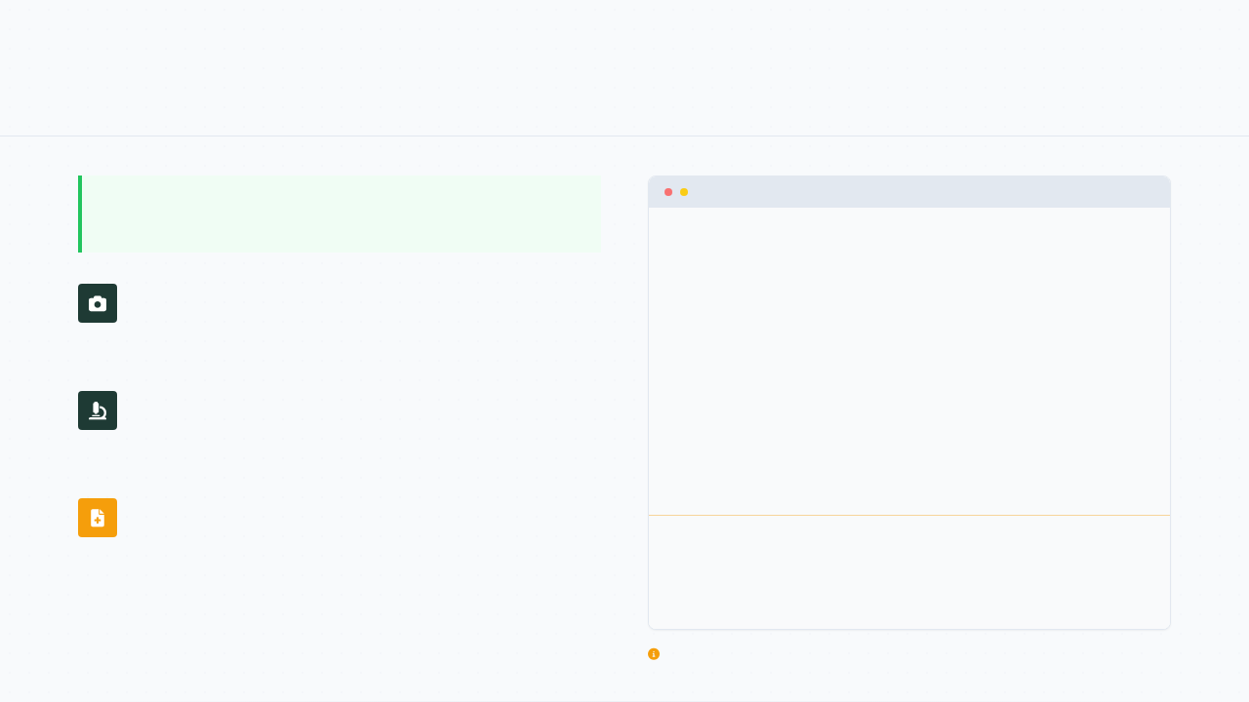
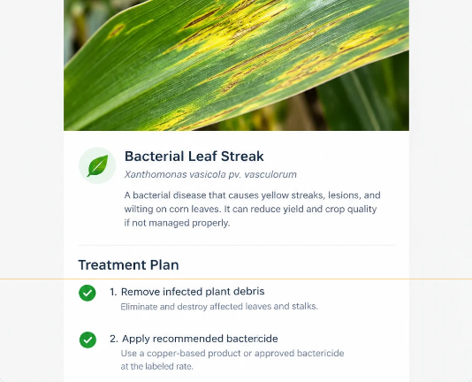
CORE FUNCTIONALITY
Project Overview
DIAGNOSTIC_INTERFACE_V4.0
A 'doctor in your pocket' for every farmer.
Snap a Photo
Capture the affected plant directly in the field using high-
resolution mobile imaging.
AI Identification
Our ensemble models identify the disease with high precision
and micro-optic clarity.
Treatment Plan
The system instantly generates a comprehensive, AI-driven
treatment plan for field action.
FIG 01. INTEGRATED FIELD DIAGNOSTIC FLOW INTERFACE

Slide 3
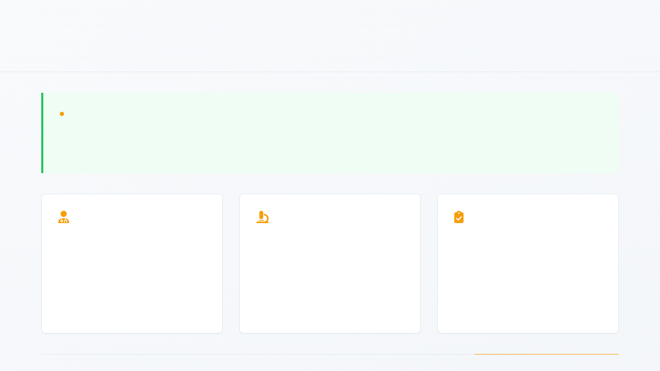
IDENTIFYING THE PAIN POINTS
The Problem Statement
DIAGNOSTIC INSIGHT
Farmers lose crops because expert help is slow and existing AI is 'book smart' but not 'street
smart.'
BARRIER 01
BARRIER 02
BARRIER 03
Expert Scarcity
The Lab-to-Field Gap
Labels vs. Cures
Professional help is often too slow and
expensive for small-scale farmers,
creating a critical delay in treatment.
Existing apps are trained on perfect
lab photos and fail in messy, real-
world field conditions with varied
lighting and noise.
Most current tools only provide a
disease name, leaving the farmer
without an actionable, local-market
cure.

Slide 4
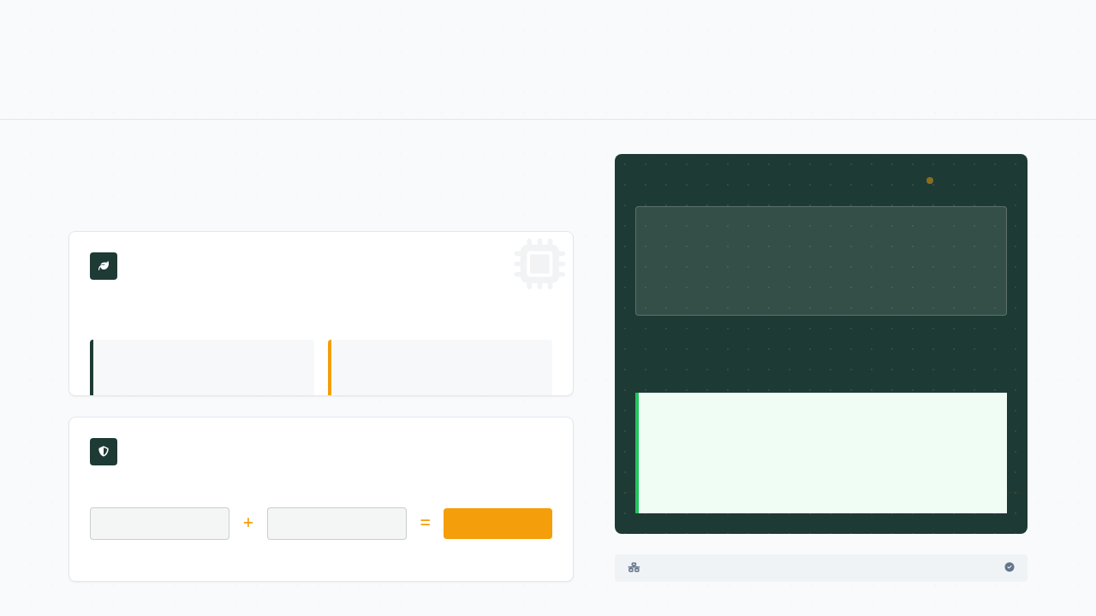
TECHNICAL INNOVATIONS
The Solution
Bridging the gap with field-ready AI and personalized LLM
guidance.
DIAGNOSTIC INTERFACE
LIVE_LLM_FEED
Google Gemini Integrated
"Your plant shows early signs of fungal blight. Recommended
action: Prune infected leaves and apply 2% copper-based
fungicide at dusk."
STREET SMARTS
Hybrid dataset merging controlled laboratory accuracy with unpredictable field
variables.
54,000
2,600
LAB SAMPLES
FIELD IMAGES
The Human Touch
DOUBLE CHECKING
Personalized guidance translates complex technical data
into actionable symptoms, treatments, and prevention
plans for any farmer.
Ensemble logic where multiple specialized architectures cross-verify findings.
ResNet50
DenseNet121
99.2% Accuracy
ENSEMBLE VOTING SYSTEM ACTIVE
GEMINI PRO V1.5

Slide 5
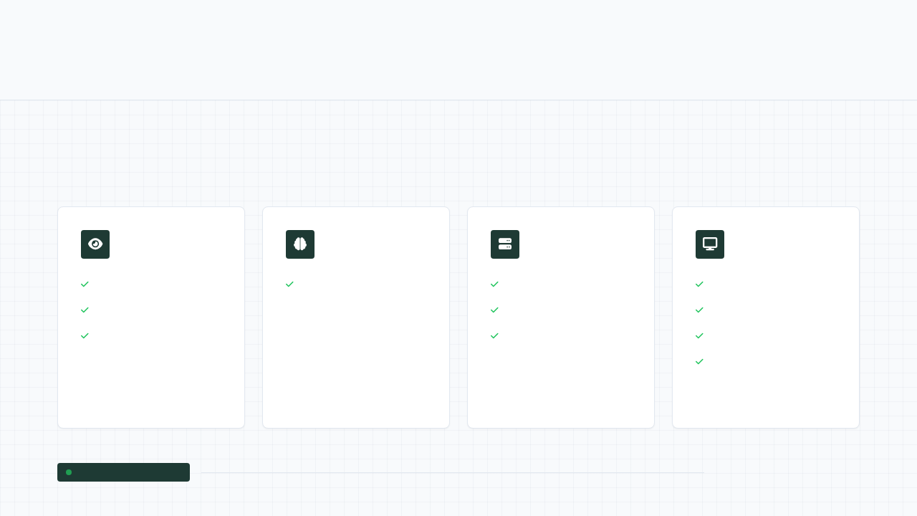
CORE ARCHITECTURE
Tech Stack
A robust, modern architecture designed for speed and intelligence,
leveraging industry-standard frameworks for end-to-end efficiency.
Vision AI
Language AI
Backend
Frontend
TensorFlow
Google Gemini API
Python
React
ResNet50
FastAPI
Vite
DenseNet121
Uvicorn
PWA
Custom CSS
TECH
STACK
SYSTEMS OPERATIONAL
DIAGNOSTIC INTERFACE V1.0

Slide 6
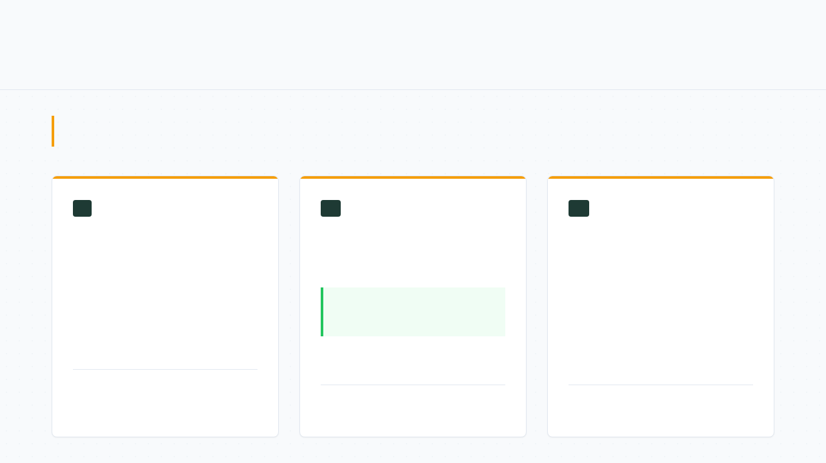
THE PRIMARY ROADBLOCKS FACED DURING DEVELOPMENT.
Technical Challenges
CORE OBJECTIVE
Overcoming data silos, latency, and cross-device friction.
01
The Data Gap
02
Software Traffic Jam
03
Device Compatibility
Aligning two completely different
datasets with inconsistent folder
structures and naming conventions.
Optimizing the backend to process
images through two AI models and an
LLM in under 5 seconds.
Designing a UI that functions as a
high-density desktop dashboard but
remains a thumb-friendly mobile app
for field use.
Target Benchmark
< 5.0s
SYSTEM CONSTRAINT: STRUCTURAL
INCONSISTENCY
PERFORMANCE THRESHOLD: LATENCY CAP
UX REQUIREMENT: HYBRID PRECISION

Slide 7
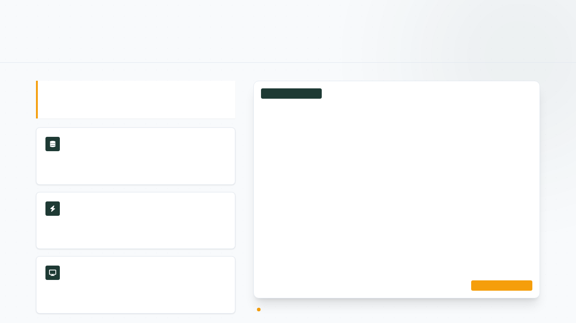
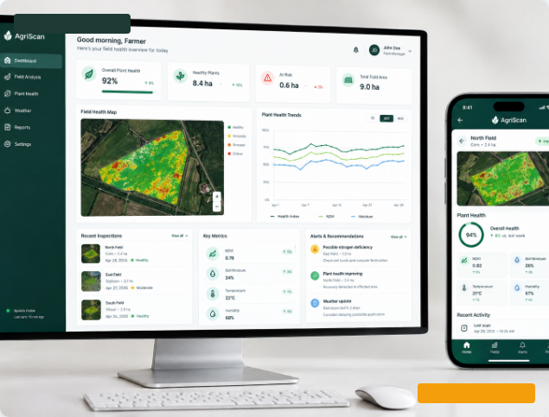
HOW THE TECHNICAL ROADBLOCKS WERE SYSTEMATICALLY RESOLVED.
Solutions to Challenges
Custom automation and responsive design ensure a
seamless user experience.
DESKTOP DEPLOYMENT
Data Mapping
Developed custom Python scripts to map and merge
disparate datasets automatically, ensuring data integrity.
Performance
Leveraged FastAPI and an optimized preprocessing pipeline
to meet the strict 5-second response target.
UI/UX Strategy
Built a PWA with a dynamic sidebar and PDF export
functionality for field-ready utility.
MOBILE PWA RESPONSE
INTERFACE DIAGNOSTIC
Side-by-side comparison: Responsive Framework v1.0

Slide 8
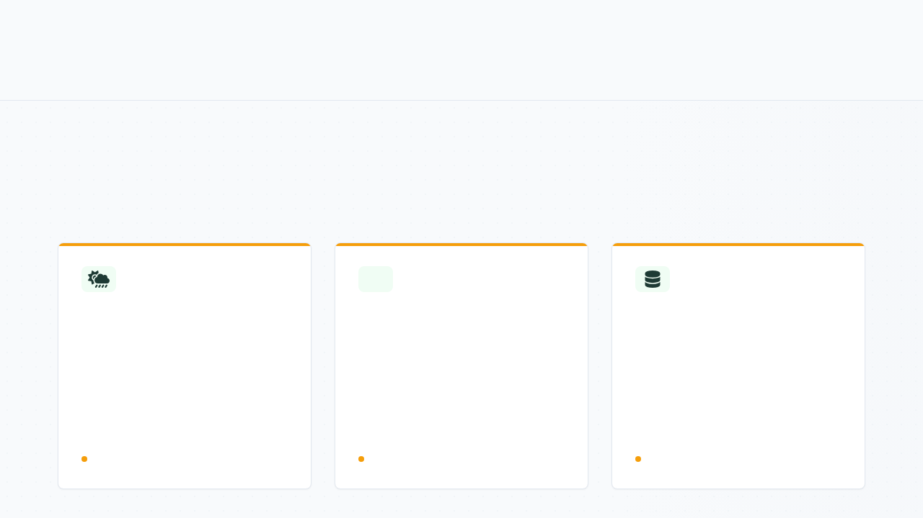
ROADMAP
Future Work
Expanding intelligence and accessibility for global
impact.
The strategic roadmap for upcoming features and platform enhancements.
Weather Intelligence
Offline Mode
Dataset Expansion
Integrating real-time weather APIs to
provide predictive diagnostics,
warning farmers against chemical
application if rain is imminent to
ensure efficacy and reduce waste.
Developing advanced local caching
and edge-inference capabilities,
allowing the diagnostic engine to
function seamlessly in remote fields
without active internet connectivity.
Continuous scaling of the agricultural
database to incorporate over 50 new
crop varieties and 200+ disease types,
broadening the app's utility for global
smallholder farmers.
DEVELOPMENT PHASE
ARCHITECTURE DESIGN
DATA ACQUISITION

Slide 9
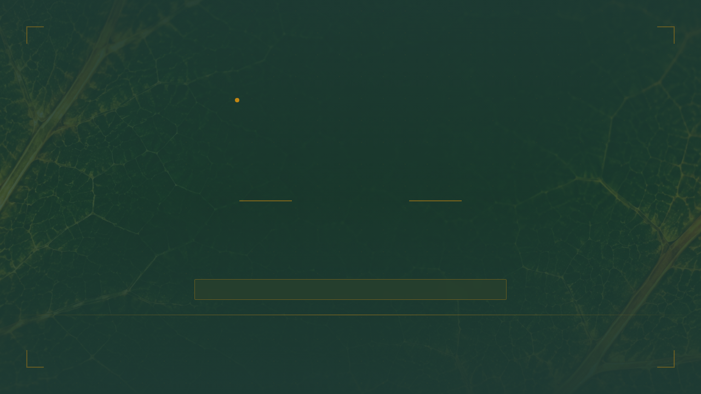
SYSTEM DIAGNOSTIC: COMPLETE
CONCLUSION
& Q&A
Bridging the gap between AI and real-world farming.
THANK YOU FOR YOUR ATTENTION. LIVE DEMO TO FOLLOW.
AGRO-PRECISION FIELDKIT // VER. 4.0.2
TERMINAL REFERENCE: FINAL_PHASE_04

